Slide 1
Melbourne Spatial Distribution
Gary Wong
Hironori Hamasaki
Maulana Rizal Ibrahim
Nadya Ulibasa
Nofaldi Putranto

Slide 2

Agenda
Objectives
Cloud Architecture
Web App demo

Slide 3
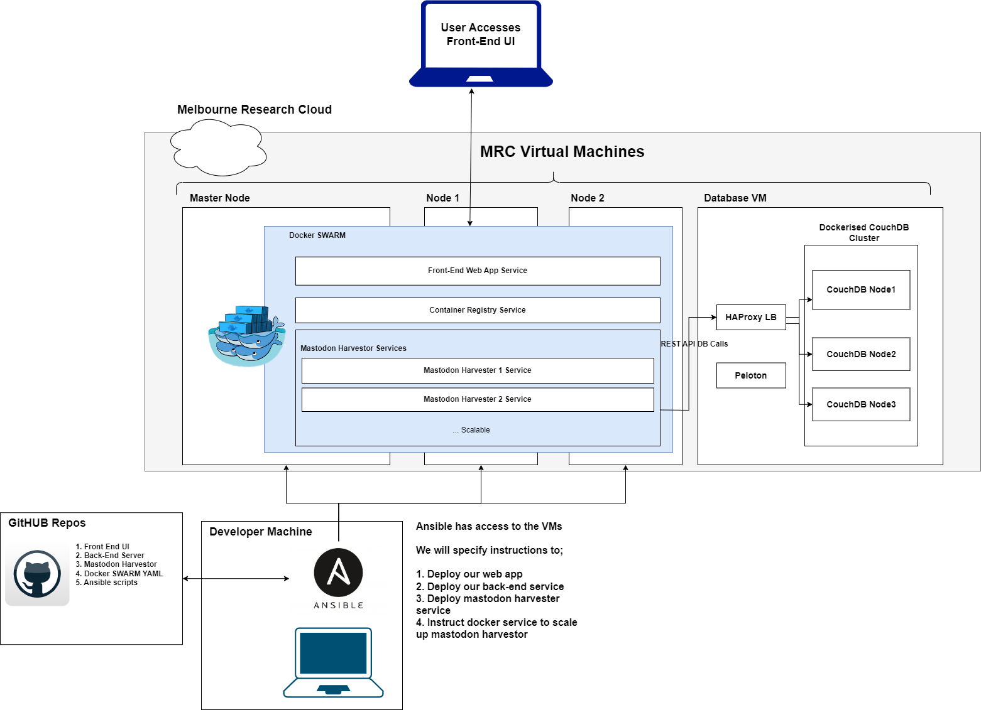
Architecture

Slide 4
Scenario
Scenario 1
Scenario 2
Scenario 3
Household income compared to number of tweets talking about rental prices
Language usage at home compared to language usage at social media platform.
Number of sports facilities in an area compared to tweets talking about exercises.

Slide 5

Web App Demo

Slide 6




Thank you
Presenter name
Email address
Website

